Slide 1
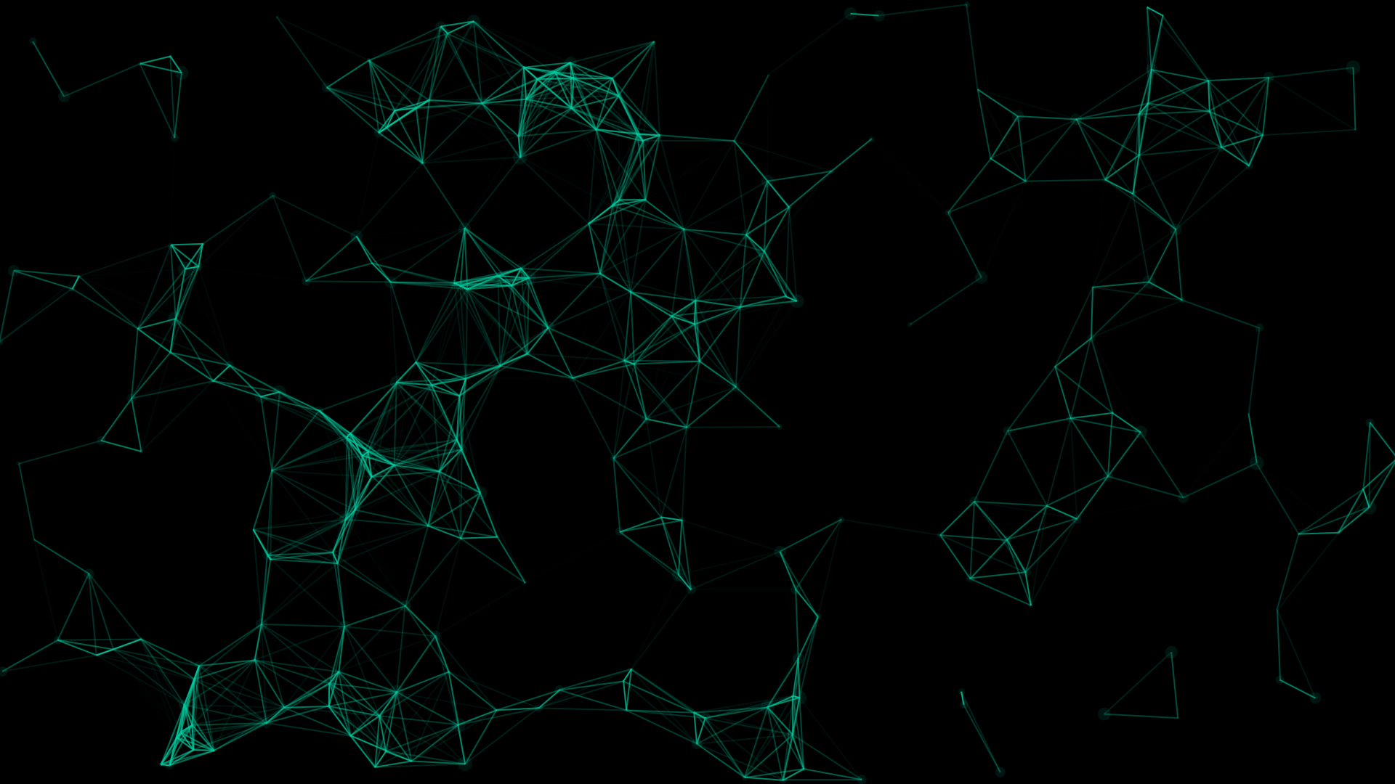
Artificial Intelligence BattleGround Serpent Showdown
Brought to you by the Topic team

Slide 2
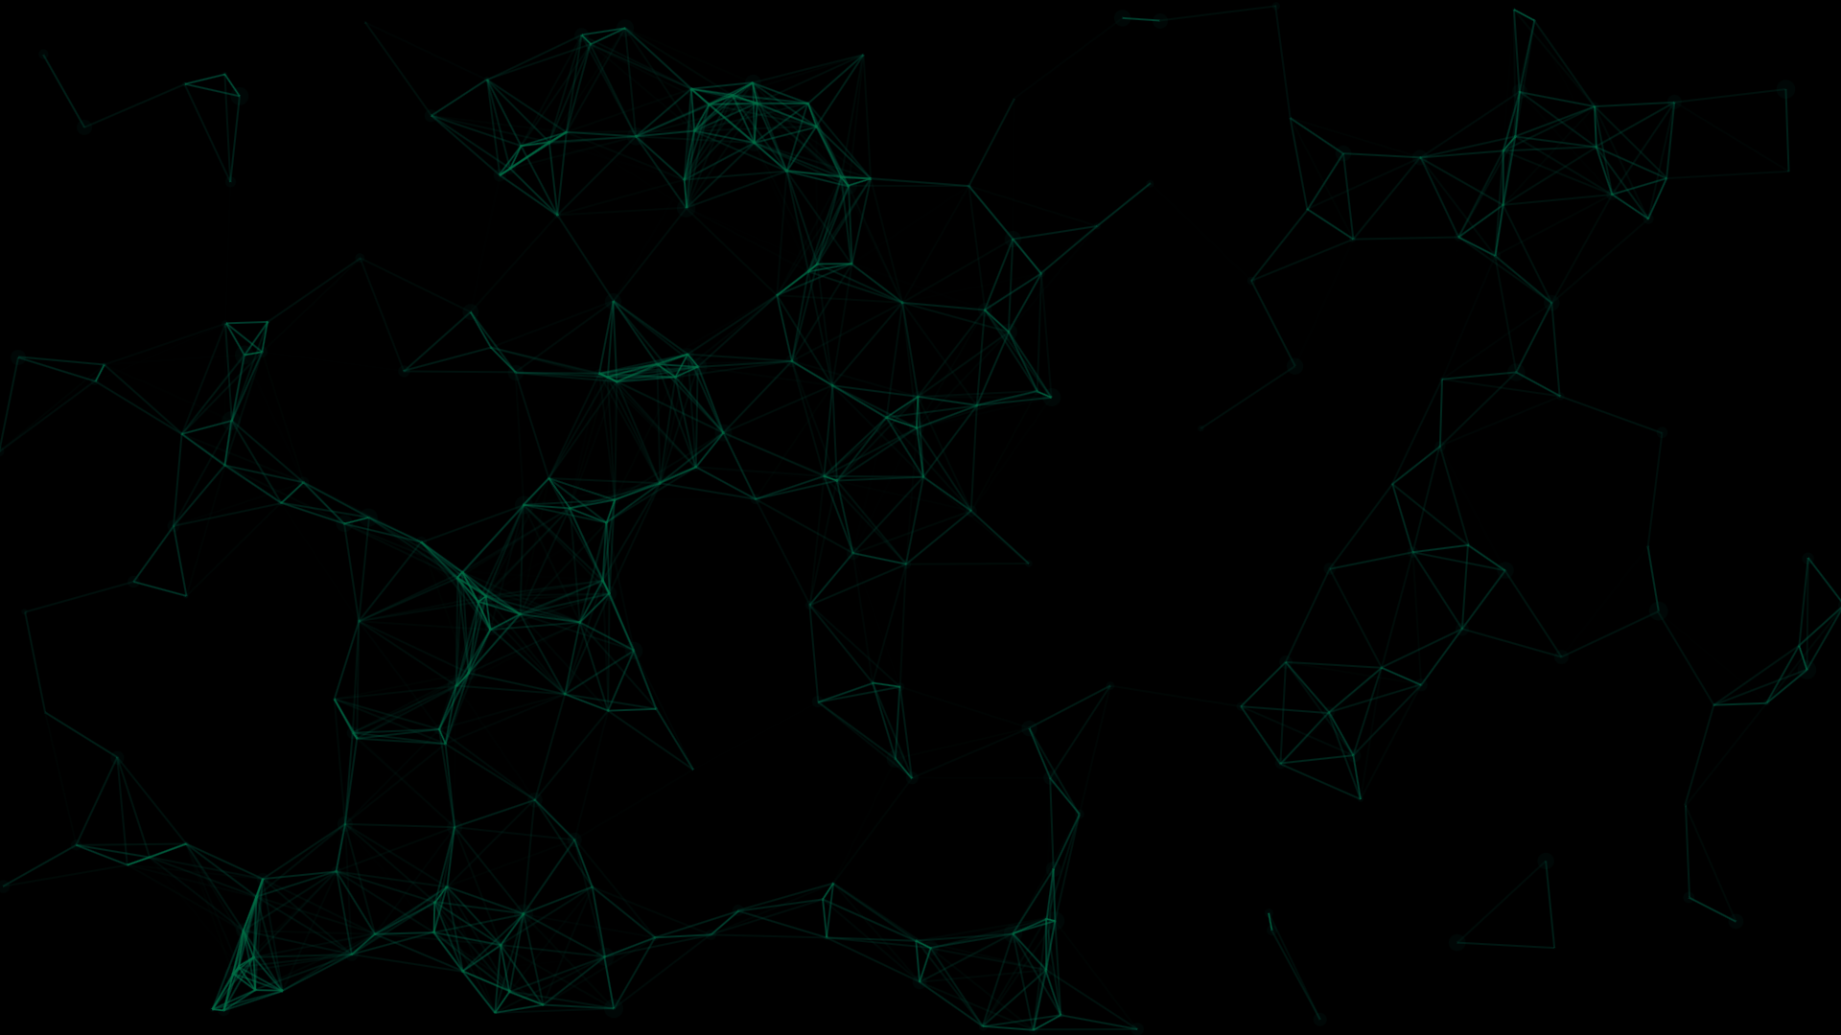
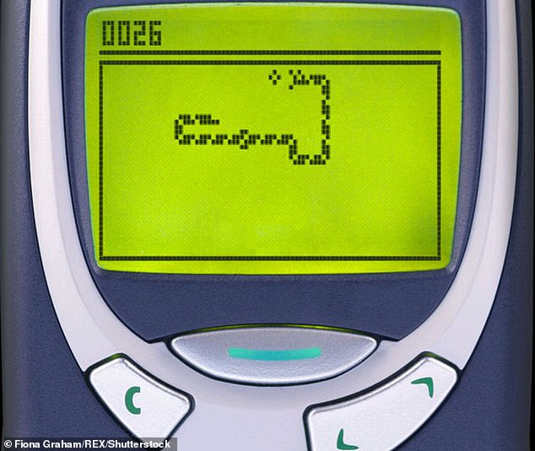
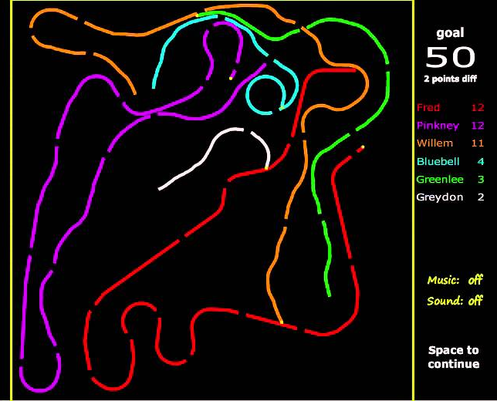
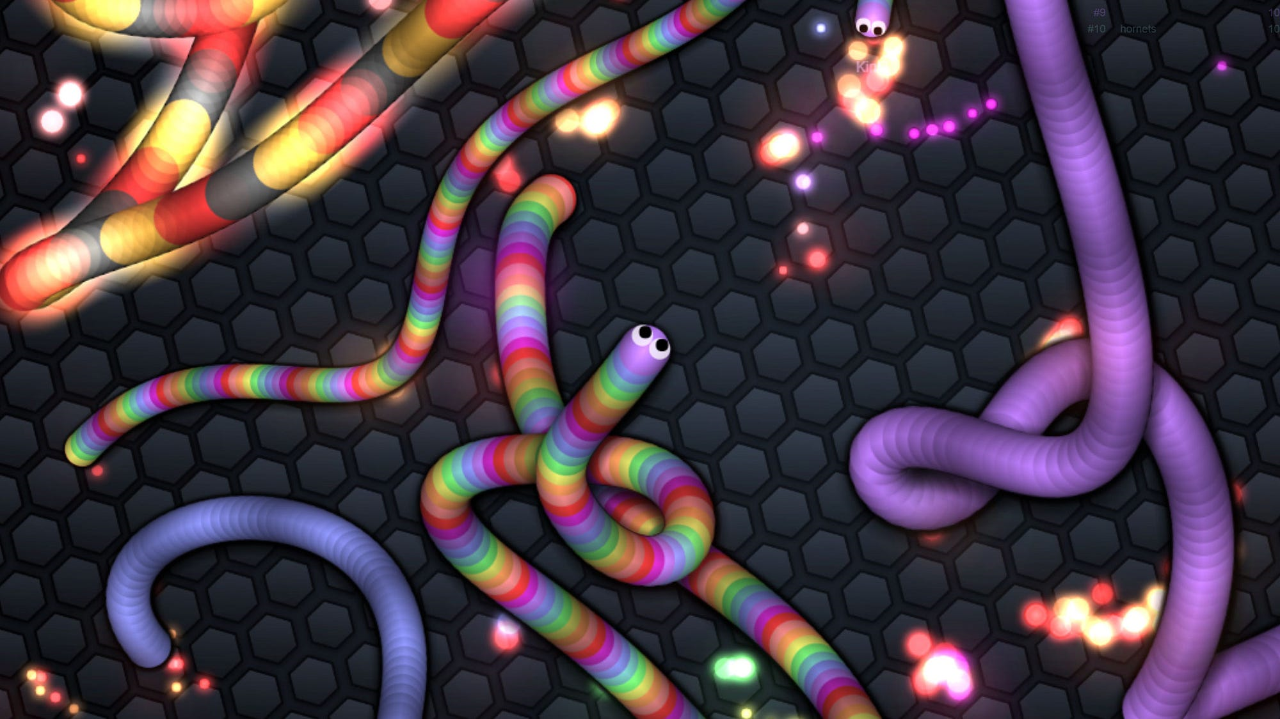


Slide 3
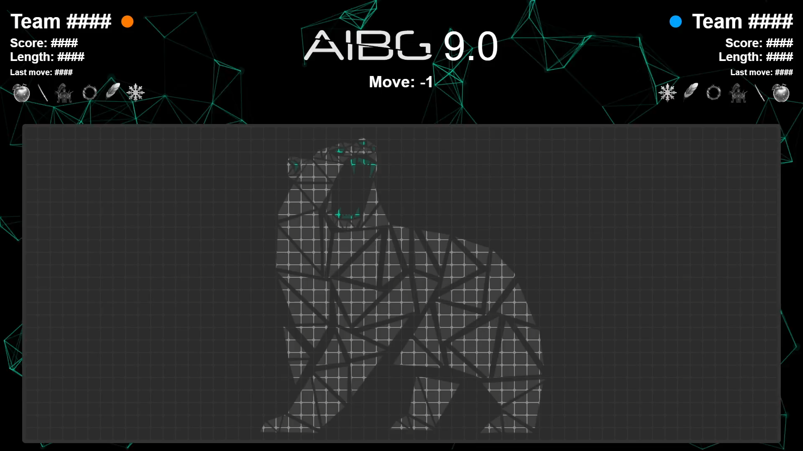

Slide 4
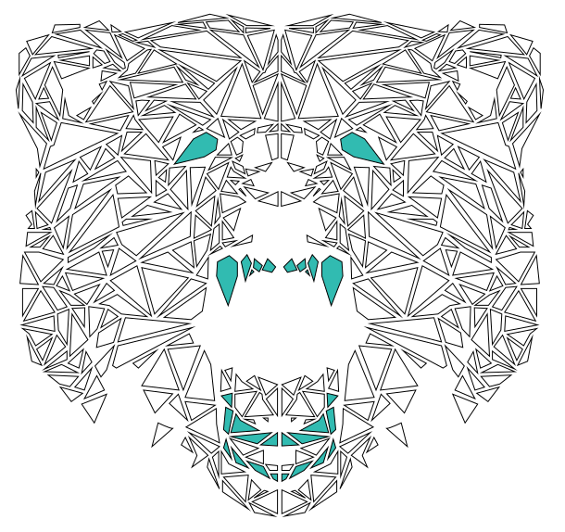
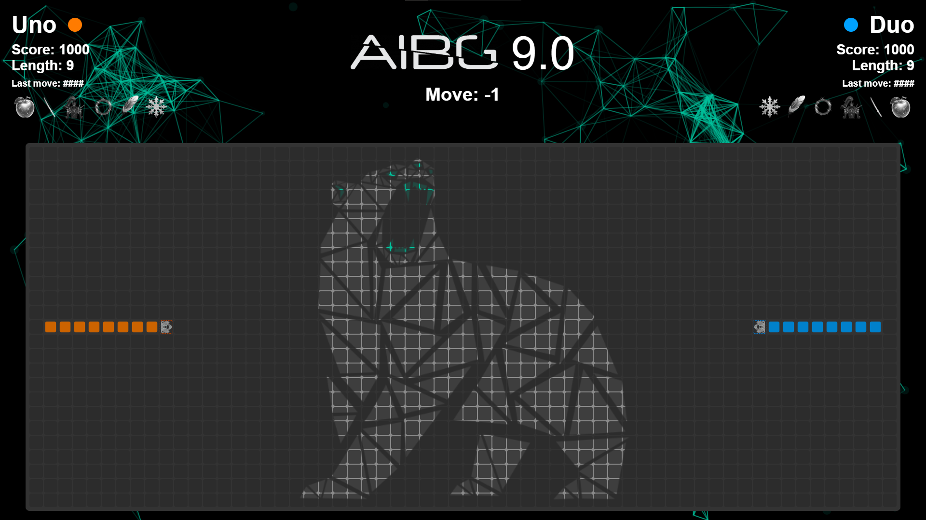
General overview (1)
Players
Start with a length of 9 on opposite sides of the board facing the center
Starting score is 1000
Side is determined randomly upon connection
Board
Size is 25 (rows) x 60 (columns)

Slide 5

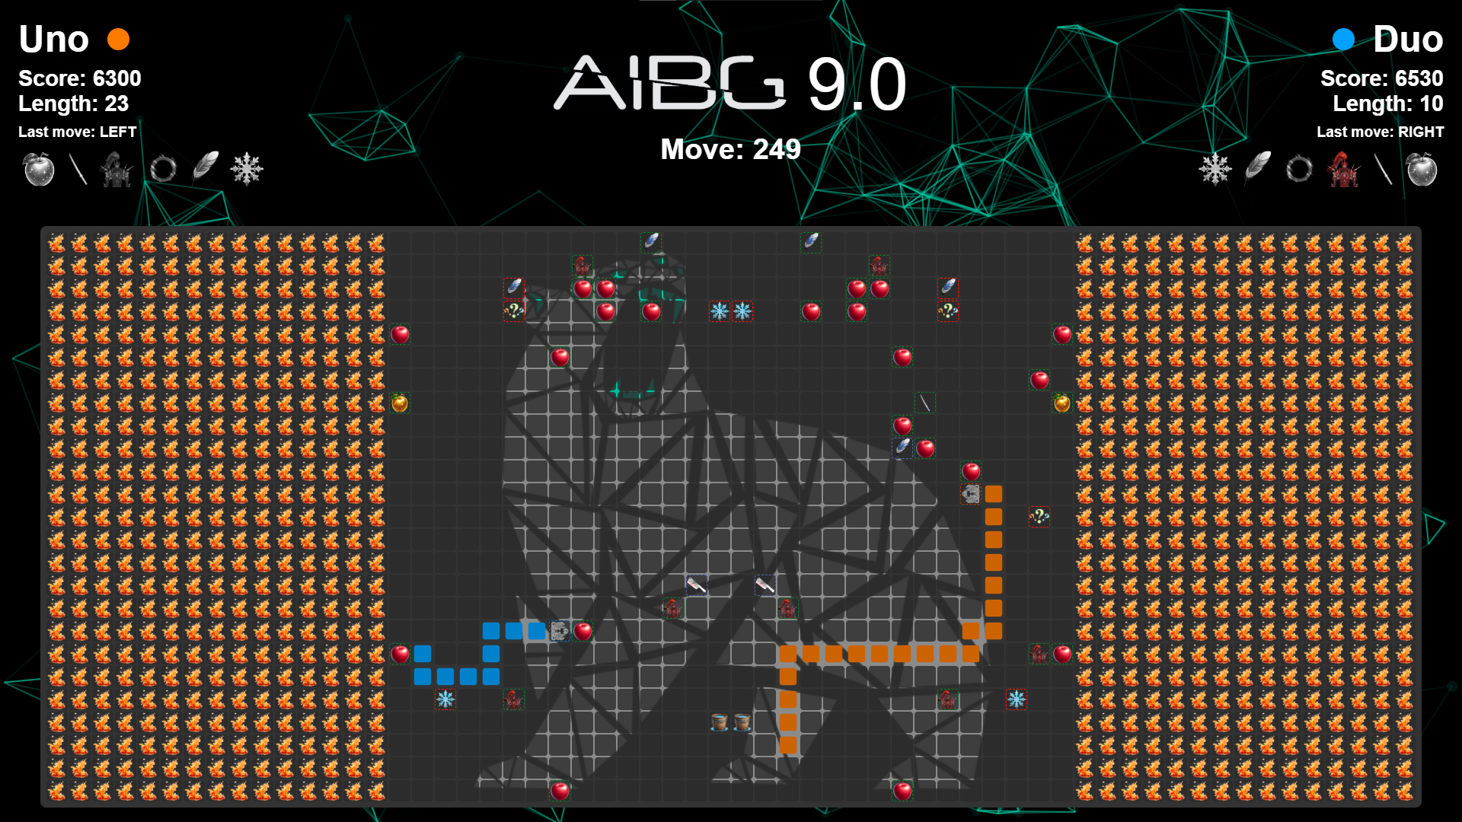
General overview (2)
Border
Starts shrinking at move 100
Shrinks by one horizontally (on each side) every 10 moves
Shrinks also vertically when aspect ratio 1x1 of board is reached
Stops shrinking when board size reaches 19x20
If part of the body gets cut off by the border, the rest of the body turns to apples
Items spawn on mirrored positions on both sides of the board
Apples spawn every 5 moves
Other items have a 10% chance of spawning on any move

Slide 6
Win conditions
Make the other agent collide (with himself/you/wall/border)
Make the other player score a reach of 0
Game ends after 900 moves
Winner is the agent with a higher score
If scores are equal, winner is determined by length

Slide 7
Rewards & Penalties
Rewards & Penalties | Score
Moving towards the center | + 20
Moving away from the center | + 10
Playing invalid move | - 50
Move timeout exceeded | - 50
Playing reverse direction move | - 30
Body segment lost | - 30

Slide 8


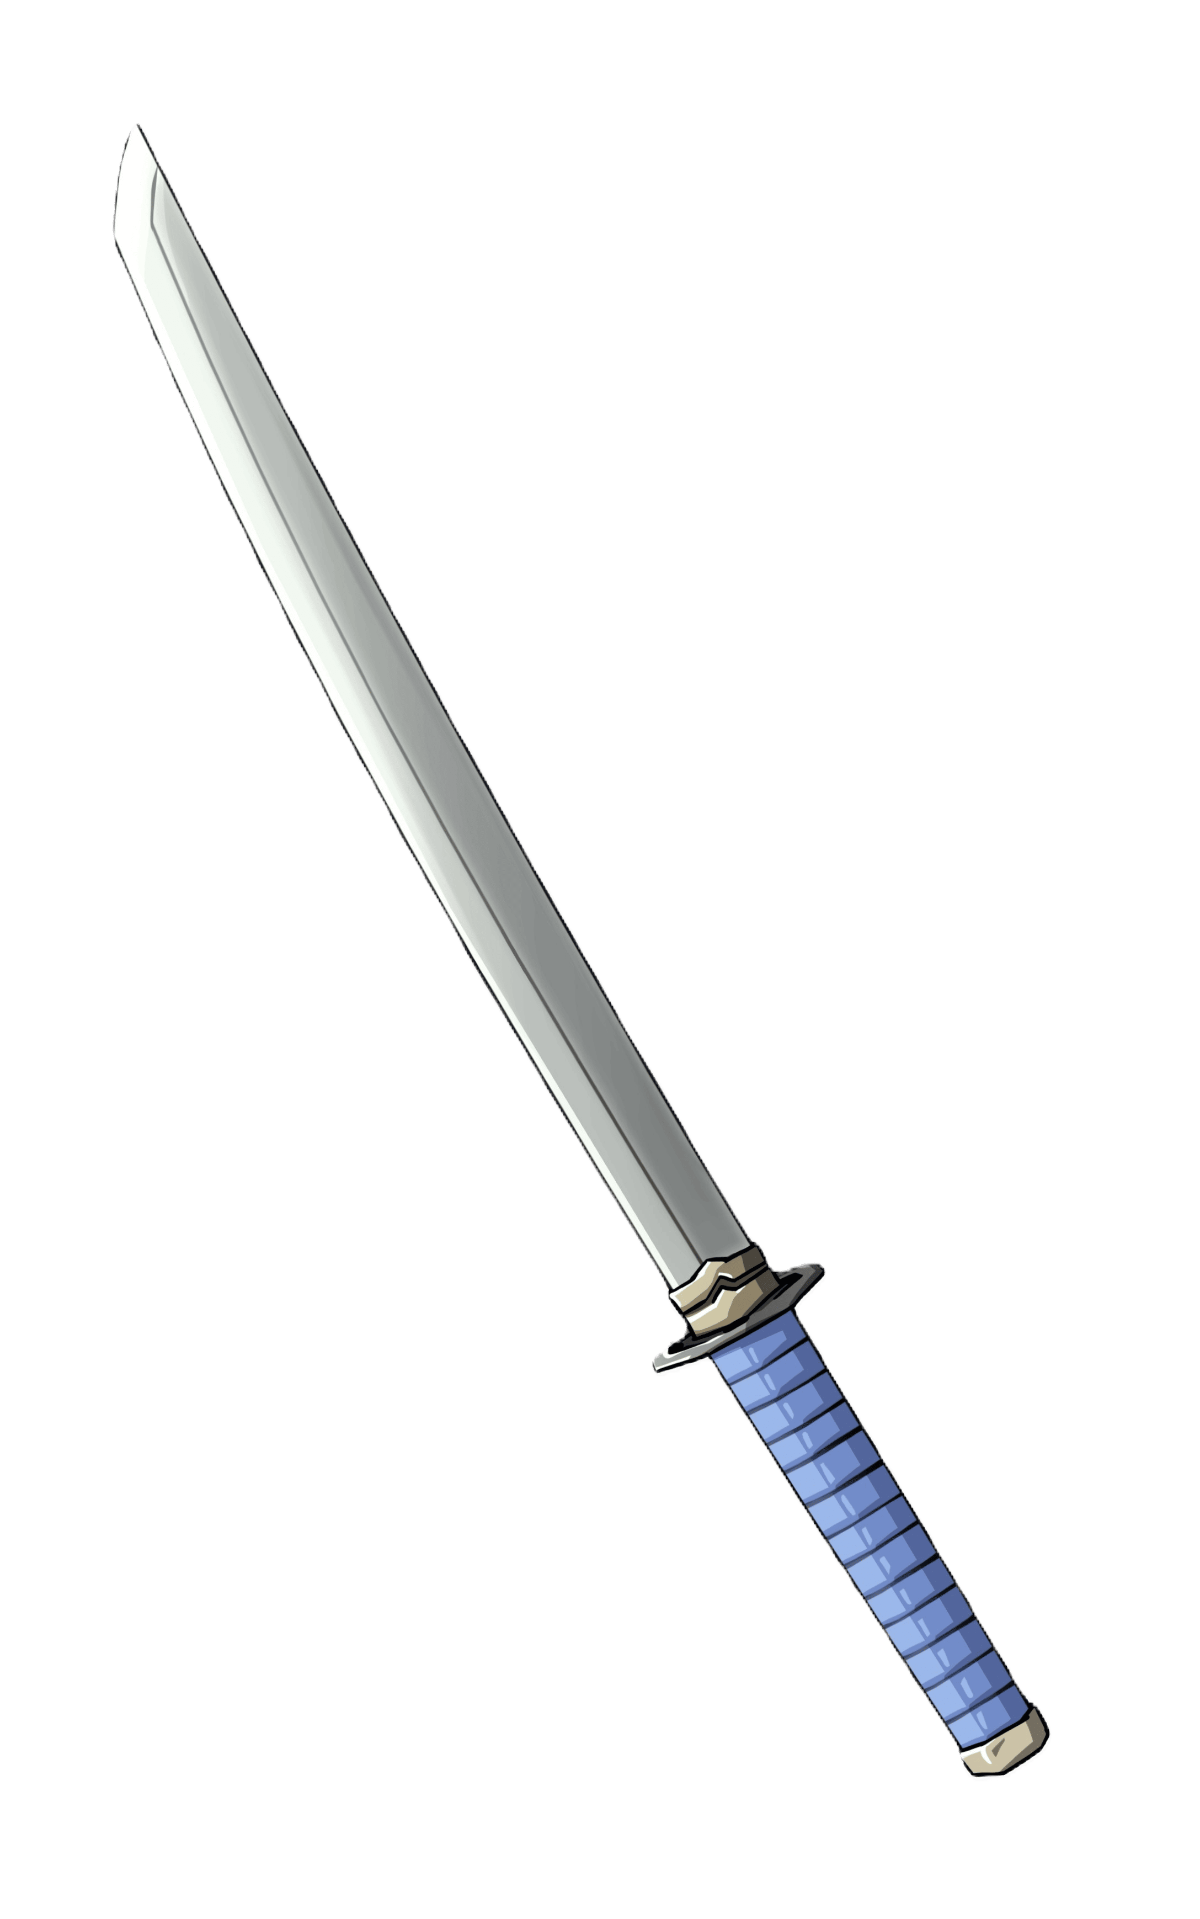






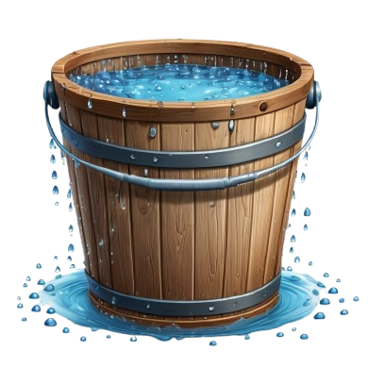
Items
10% chance of spawning on any move (except apple)
Affect „Random” will be changed to self/enemy/both upon spawning
Sprite | Name | Type | Duration (moves) | Pick up reward | Affect | Spawn weight
 | Apple | apple | 1 | 50 | Self | Every 5 moves
 | Golden apple | golden-apple | 5 | 70 | Self | 9
 | Katana | katana | 10 | 60 | Self | 7
 | Armour | armour | 15 | 60 | Self | 7
 | Shorten | shorten-XX | 1 | 30 | Random | 4
 | Tron | tron | 15 | 50 | Random | 3
 | Freeze | freeze | 8 | 30 | Enemy | 4
 | Leap | leap | 5 | 80 | Random | 5
 | Nausea | nausea | 1 | 90 | Enemy | 7
 | Reset borders | reset-borders | 1 | 30 | Map | 1

Slide 9
Apple
Explanation of how it works…
Gif of player picking the item up in game

Slide 10
Your task
During the next 20 hours, create an AI agent that will go head-to-head against other agents in a 1v1 in our custom-made game
Agent can be coded in ANY programming language
As long as you are able to connect the server via web sockets (topic manual)
You may use any tools (including LLM-s) at your disposal
You may NOT receive any outside help
Battles will be held in a tournament format
3 rounds per matchup

Slide 11
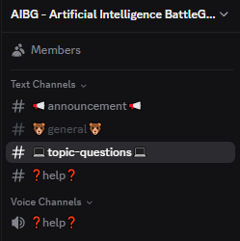

Sidenotes
Tomorrow morning, we will come to you to test connecting to the cloud server
For technical details, consolidate the Topic manual
Communication via Discord
Change your username to „First name | Team name”
At least one member of the team must always be present
Otherwise, you will be disqualified

Slide 12
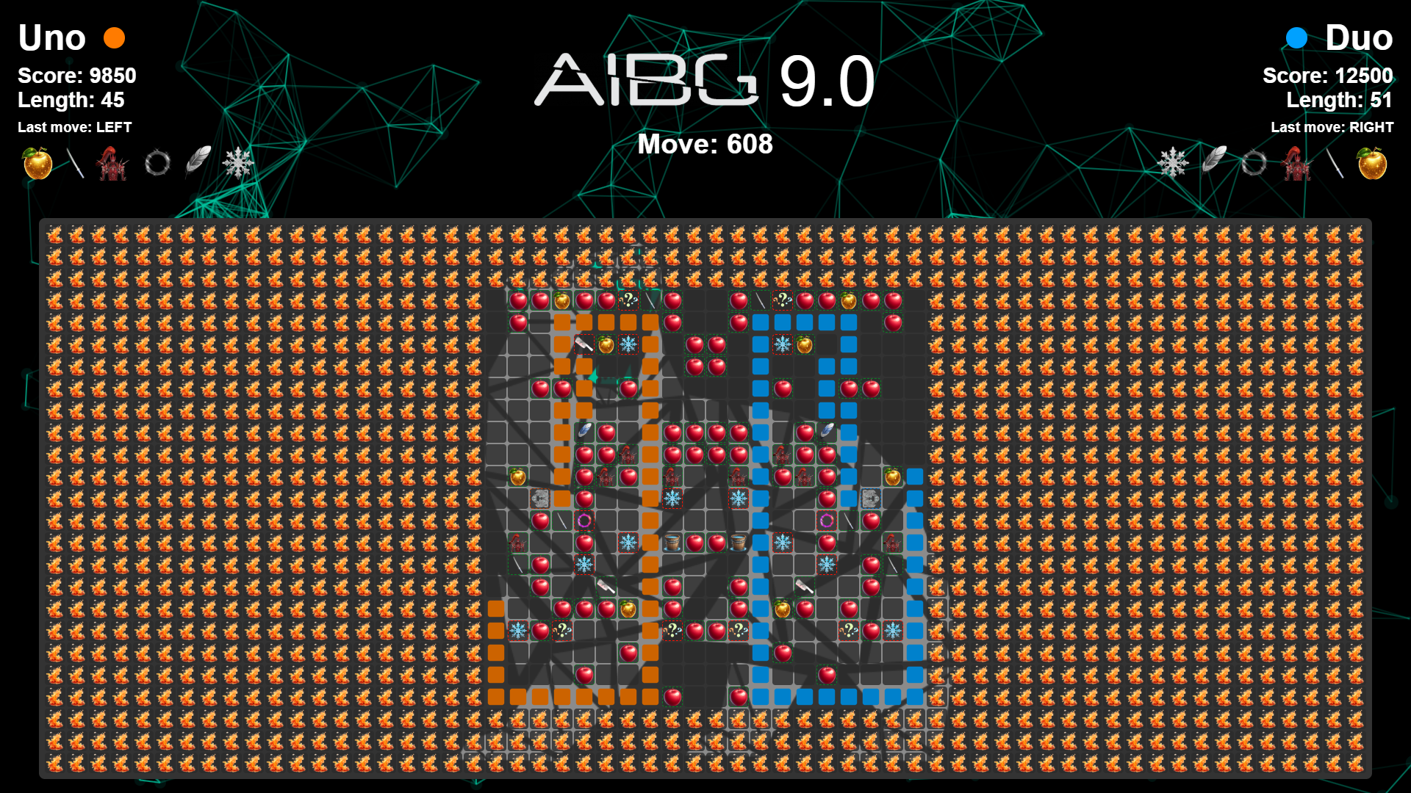
Questions?

Slide 13
GOOD LUCK!

